Slide 1

Accounting Clinic I
McGraw-Hill/Irwin
Copyright © 2013 by The McGraw-Hill Companies, Inc. All rights reserved.

Slide 2

Accounting Clinic I
Basic Accounting
Principles
With contributions by
Stephen H. Penman – Columbia University
Clinic I-<number>

Slide 3
Introduction
Accounting clinic I contains the following:
A brief review of the four financial statements
Examples of how each financial statement is prepared
A summary of the principles of measurement in financial statement
Clinic I-<number>

Slide 4
The Financial Statements
Balance Sheet
Income Statement
Cash Flow Statement
Statement of Shareholders’ Equity
Clinic I-<number>

Slide 5
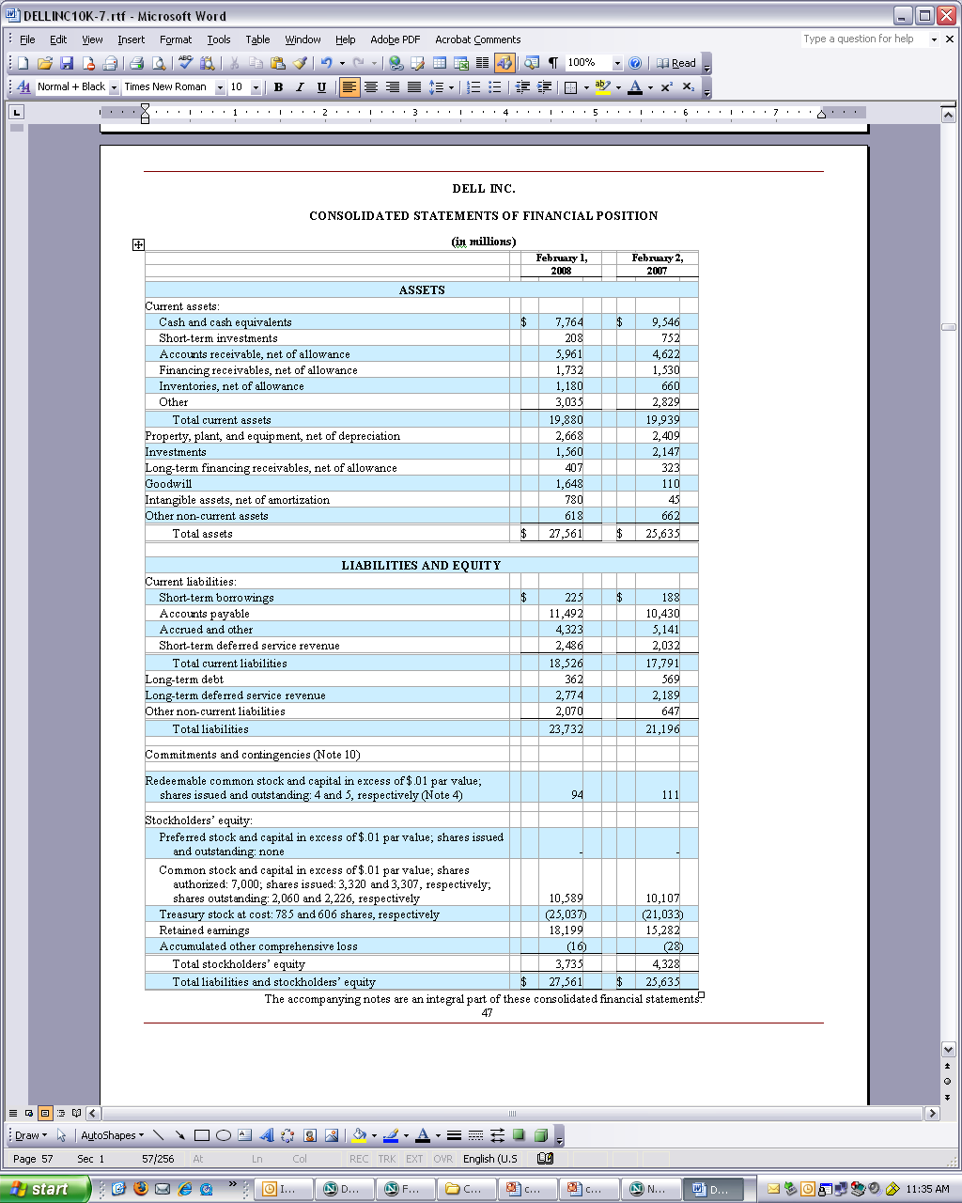
The Balance Sheet: Dell Inc.
Clinic I-<number>

Slide 6
The balance sheet reports the assets of the firm at a point in time and the claims against those resources. The claims are broken up into liabilities and shareholders’ equity.
Clinic I-<number>

Slide 7
The Form of the Balance Sheet
Assets = Liabilities + Shareholders’ Equity
or
Shareholders’ Equity = Assets – Liabilities
Assets are economic resources that produce future earnings.
Liabilities are obligations to transfer assets or provide services to parties other than the owners.
Equity is the owners' residual interest in the assets of an entity that remains after deducting the liabilities.
Clinic I-<number>

Slide 8
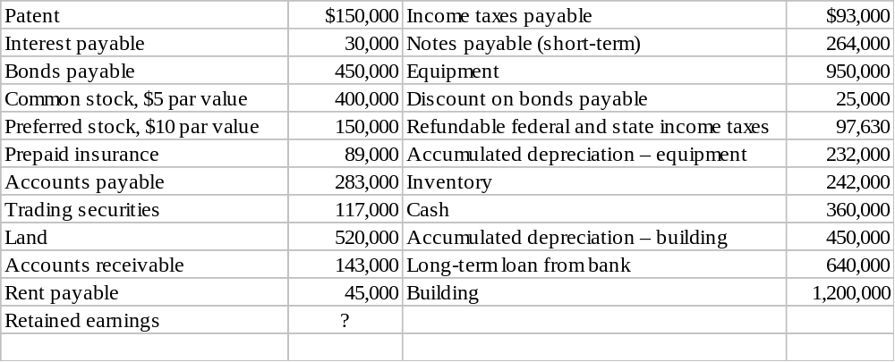
Example - Balance Sheet Preparation
Presented below are selected accounts of Biking Corporation at December 31, 2008:
Required:
Prepare a classified balance sheet.
Clinic I-<number>

Slide 9
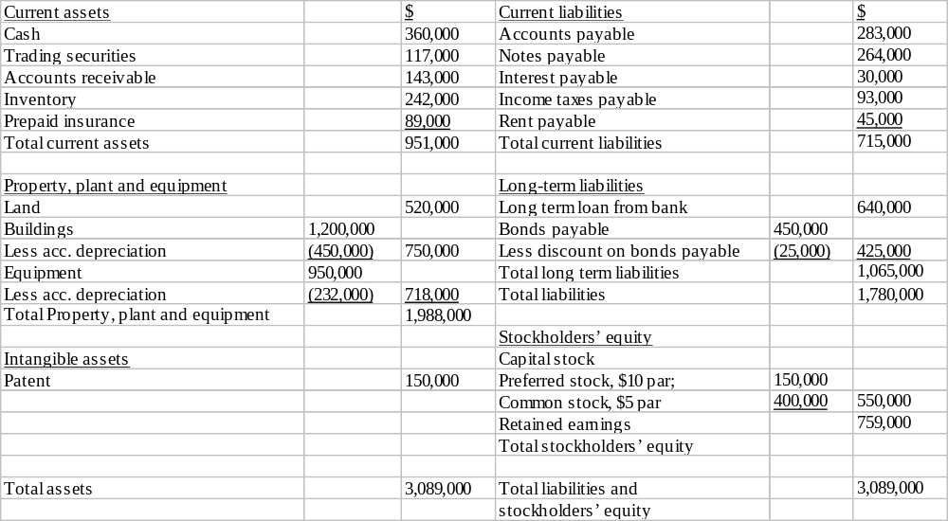
Solution
Retained earnings are calculated as a plug number.
Clinic I-<number>

Slide 10
The balance sheet reports assets and the claims on those assets at a point in time.
The other three financial statements summarize the effects of transactions and economic events occurring between two balance sheets dates.
The income statement reports revenues less expenses (earnings) that increase owners' equity between two balance sheet dates.
Clinic I-<number>

Slide 11
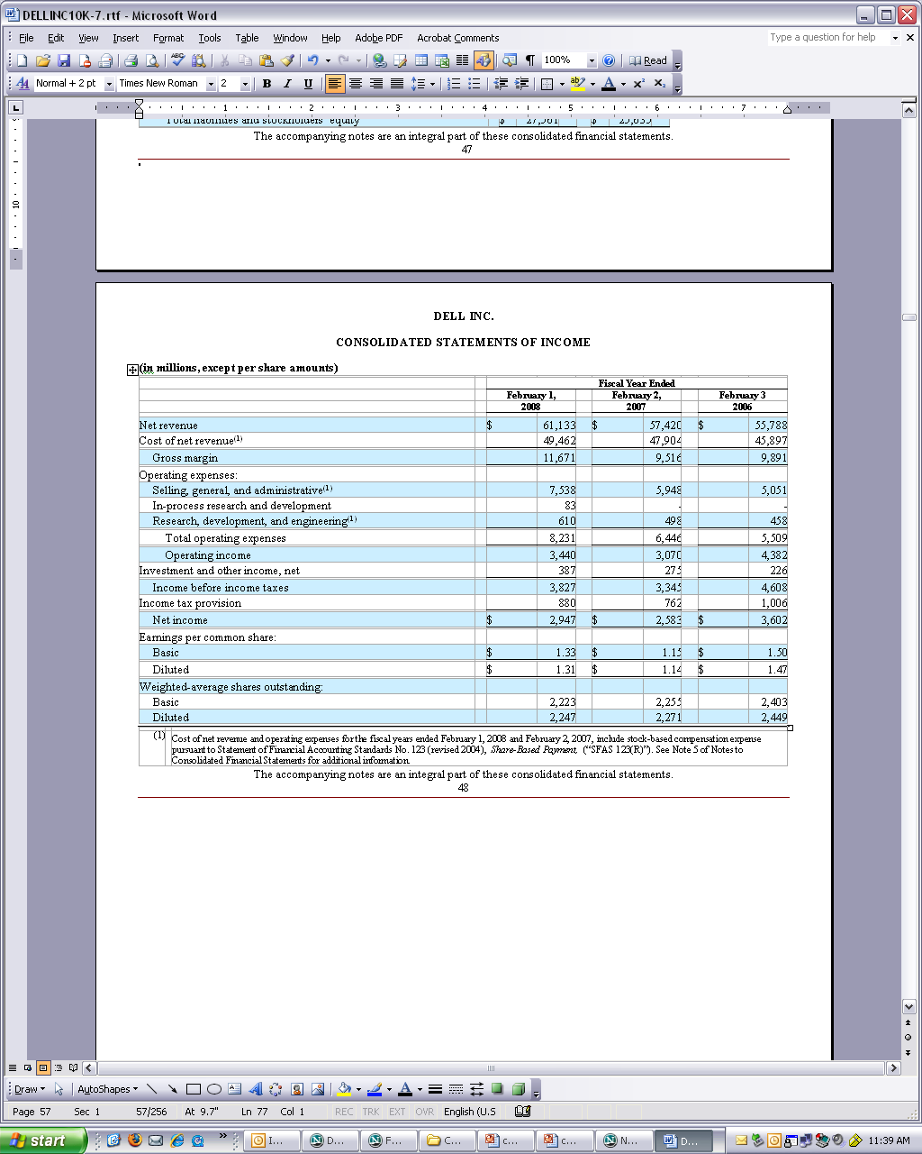
The Income Statement: Dell Inc.
Clinic I-<number>

Slide 12
The Form of the Income Statement
Net Revenue – Cost of Goods Sold = Gross Margin
Gross Margin – Operating Expenses = Operating Income before Tax (EBIT)
Operating Income before Tax – Interest Expense = Income before Taxes
Income before Taxes – Income Taxes = Income after Taxes (and before Extraordinary Items)
Income before Extraordinary Items + Extraordinary Items = Net Income
Net Income – Preferred Dividends = Net Income Available to Common
Clinic I-<number>

Slide 13
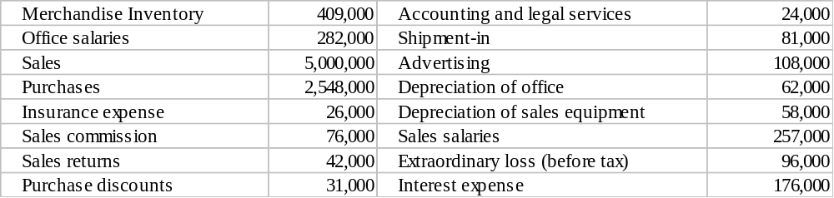
Example - Income Statement Preparation
below are selected ledger accounts of Grant Corporation at December 31, 2008:
A physical inventory indicates that the ending inventory is $547,000.
Assume a tax rate of 35%.
Required:
Prepare a condensed income statement
Clinic I-<number>

Slide 14
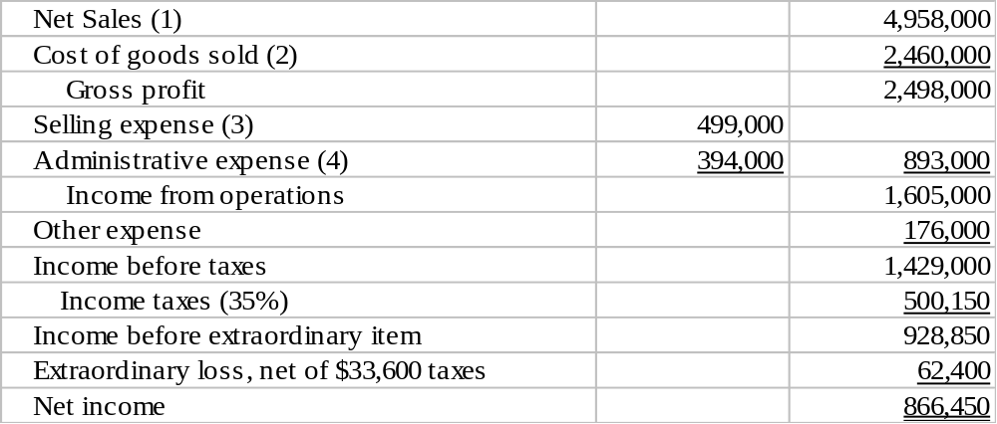
Solution
(1) 5,000,000-42,000
(2) 409,000+(2,548,000+81,000-31,000)-547,000
(3) 257,000+76,000+108,000+58,000
(4) 282,000+26,000+24,000+62,000
Clinic I-<number>

Slide 15
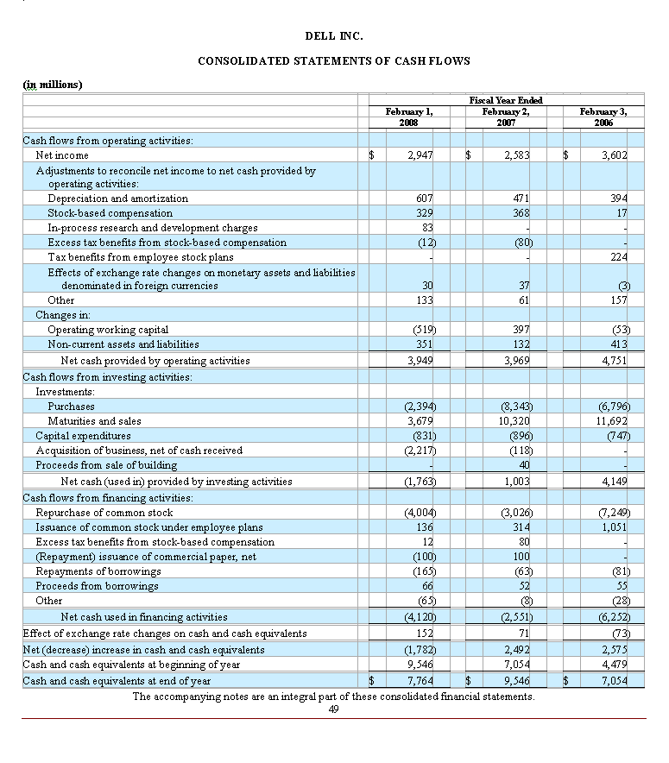
The Statement of Cash Flows : Dell Inc.
Clinic I-<number>

Slide 16
The statement of cash flows explains the change in cash during the period in terms of cash provided by or used for operating, investing and financing activities.
Clinic I-<number>

Slide 17
The Form of the Cash Flow Statement
Change in Cash = Cash from Operations
+ Cash from Investing
+ Cash from Financing
Clinic I-<number>

Slide 18
The Form of the Cash Flow Statement
The primary purpose of a statement of cash flows is to provide relevant information about the cash inflows and outflows of an enterprise during a period. The statement has three main sections:
Cash Flows from Investing Activities - Investing activities involve acquiring and disposing of debt or equity investments, property, plant and equipment and other productive assets used in the production of goods or services by the enterprise (other than materials that are part of the enterprise's inventory).
Clinic I-<number>

Slide 19
The Form of the Cash Flow Statement
Cash Flows from financing Activities - Financing activities involve obtaining resources from owners and providing them with a return on their investment; borrowing money and repaying amounts borrowed, and obtaining and paying for other resources obtained from creditors on long-term credit.
Cash Flows from operating Activities - Operating activities involve all transactions and other events that are not defined as investing or financing. Operating activities generally involve producing and delivering goods and providing services. Cash flows from operating activities are generally the cash effects of transactions and other events that enter into the determination of net income.
Clinic I-<number>

Slide 20
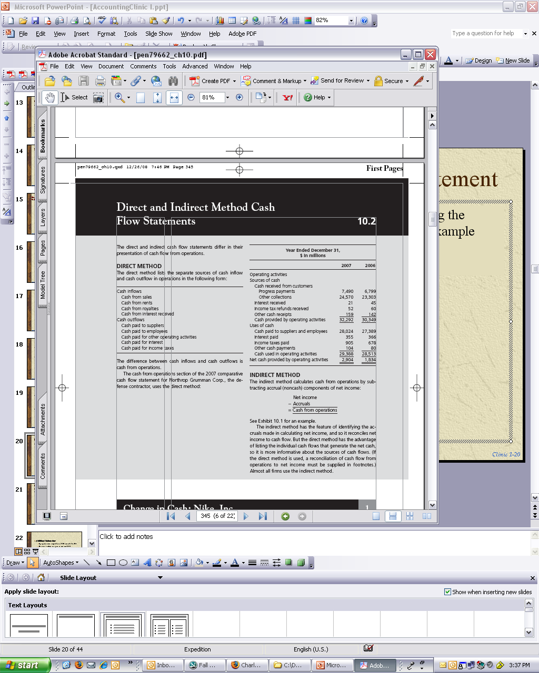
Direct Method Cash Flow Statement
A few firms report cash flow from operations using the “direct method” (see Chapter 10). Here is an example form Northrop Grumman Corp.:
Clinic I-<number>

Slide 21
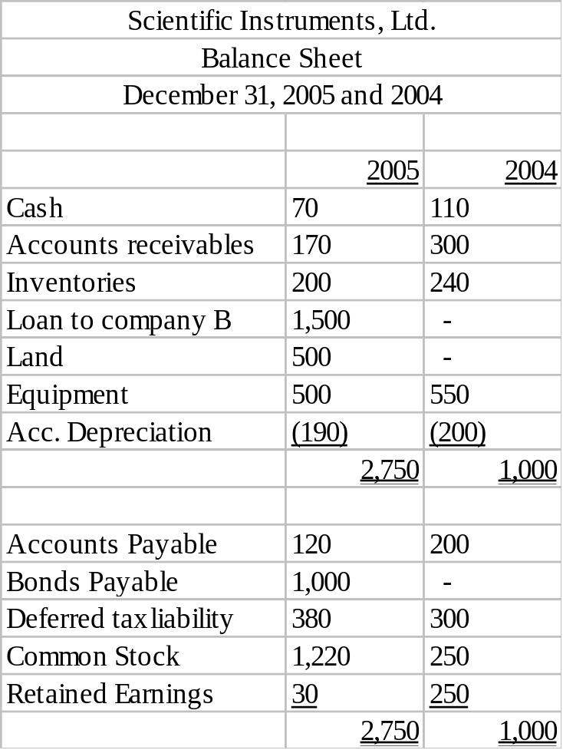
Example – Preparation of a cash flow statement
Presented below are the balance sheets of Scientific Instruments, Ltd. for December 31, 2005 and 2004
Clinic I-<number>

Slide 22
Additional Information:
  Equipment with original cost of $50 was sold for $35
  Dividend declared and paid in cash was $300
  Stocks and Bonds were issued for cash
  Net income reported was $80.
Required:
Prepare a statement of cash flow for 2005
Note: Cash from operating activities involves adjusting net income for all the non-cash items in net income.
Clinic I-<number>

Slide 23
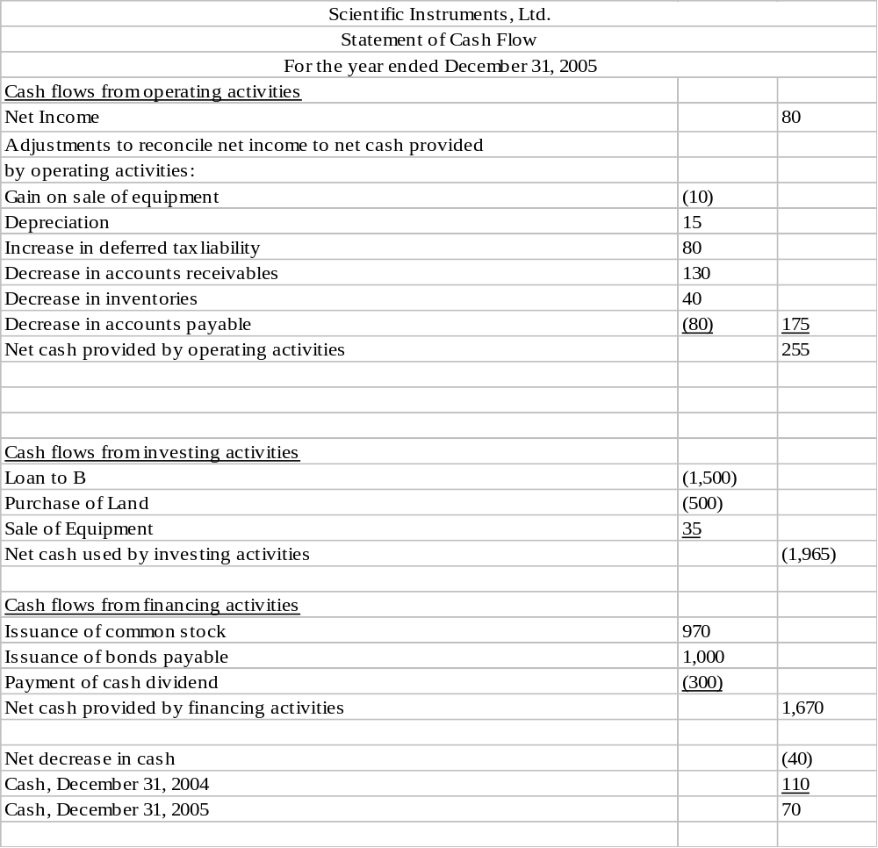
Solution
Clinic I-<number>

Slide 24
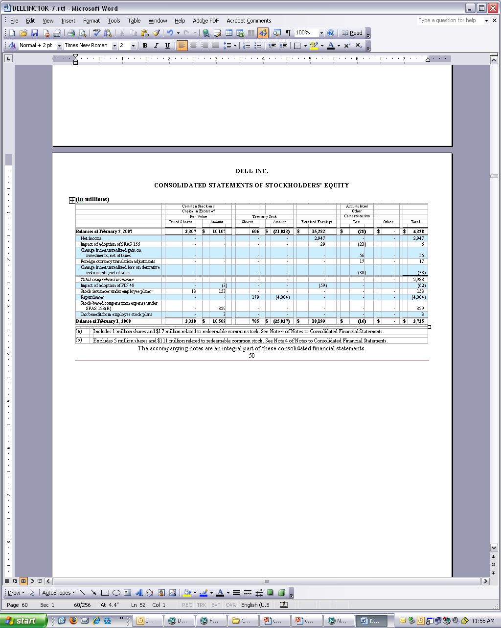
The Statement of Stockholders’ Equity:
Dell Inc.
Clinic I-<number>

Slide 25
Shareholder’s Equity
Has two primary components:
  contributed capital which represents stockholders’ investment – common stock (par value) and additional paid in capital, and
  retained earnings which equals cumulative net income minus cumulative dividends since the formation of the company. (Dividends are distributions of assets to stockholders.)
Clinic I-<number>

Slide 26

Comprehensive Income
Comprehensive income is net income (from the income statement) plus “other comprehensive income”
To avoid earnings fluctuations some of the unrealized gains/losses are reported in “other comprehensive income” and not included in net income.
Clinic I-<number>

Slide 27
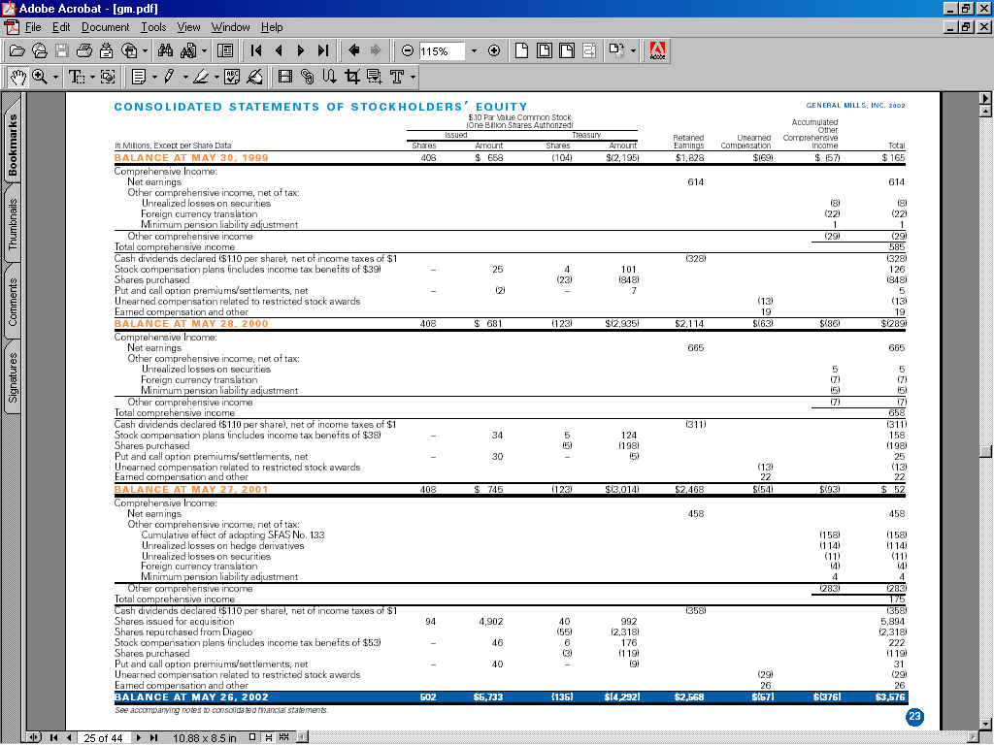
Clinic I-<number>

Slide 28
The Stocks and Flows Equation
Ending equity = Beginning equity + Total (comprehensive) income
– Net payout to shareholders
Comprehensive income = Net income + Other comprehensive income
Net payout to shareholders = Dividends + Share repurchases -Share issues
Clinic I-<number>

Slide 29
The Articulation of the Financial Statements
Cash Flow Statement
Cash from operations
Cash from investing
Beginning Balance Sheet
Ending Balance Sheet
Cash from financing
Cash
Net change in cash
Cash
+ Other Assets
+ Other Assets
Statement of Shareholders’ Equity
Total Assets
Total Assets
Investment and
disinvestment
- Liabilities
by owners
- Liabilities
Net income and other earnings
Owners’ equity
Net change in owners’ equity
Owners’ equity
Income Statement
Revenues
Expenses
Net income
Clinic I-<number>

Slide 30
Principles of Measurement
Two types of measurement are used in financial statements
Fair value accounting
Assets and liabilities are reported at their “fair value” and gains and losses from revaluing them are reported in the income statement or as part of other comprehensive income in the equity statement. Fair value is either market value or an estimate of value.
Clinic I-<number>

Slide 31
Historical cost accounting
Assets and liabilities are reported at their historical cost (the dollar amount paid when they were acquired or incurred). In subsequent periods, those costs are amortized to the income statement as the assets are deemed to have been used up in operations or as liabilities accrue costs.
GAAP accounting uses both types of measurement.
Clinic I-<number>

Slide 32
Mark-to Market Accounting
Under U.S. GAAP, the following assets and liabilities are approximately at market value:
  Cash and Cash Equivalents
  Short-term investments
  Accounts payable
  Equity Investments considered trading securities or “available for sale.” See Accounting Clinic III.
The following assets and liabilities are measured with estimates of that are usually close to market value:
  Net Accounts Receivables (net of estimate of likely bad debt.)
  Accrued and Estimated Liabilities
  Note that debt (short-term and long-term) is at historical cost but that is typically close to fair value)
Clinic I-<number>

Slide 33
Historical Cost Accounting
The following assets and liabilities are at historical cost on the balance sheet:
  Long-term Tangible Assets (depreciated)
  Recorded Intangible Assets (amortized)
  Goodwill (not amortized)
These assets can be written down if their value is deemed to have been impaired, but are never written up (in the U.S.).
Clinic I-<number>

Slide 34
Mixed Accounting Measurement
The following assets are sometimes measured at historical cost and sometimes at fair values:
  Inventories: Lower of cost or market rule applies
  Debt investments
    Trading
    Available-for-sale
    Held to maturity
  Equity investments
    Trading
    Available-for-sale
See Accounting Clinic III
Clinic I-<number>

Slide 35
Historical Cost Accounting in The Income Statement
Revenue recognition principle - value added is recognized when:
  The earnings process is substantially accomplished
  Receipt of cash is reasonably certain
Matching principle -
  Expenses are recognized in the income statement by their association with revenues for which they are incurred.
  The earnings number reflects net value added from revenues, that is, net of matched expenses.
Go to Accounting Clinic II for more on matching
Clinic I-<number>

Slide 36
Cost of Goods Sold: An Application of Matching
Cost of goods sold is an accrual concept, calculated in the following way:
  Inventory, beginning XXX
  + Purchases XXX
  Goods available for sale XXX
  - Inventory, ending (XXX)
  Cost of Goods Sold XXX
The beginning balance of inventory and purchases of goods during the year sum up to the total goods that the firm could have sold during the year.
The ending balance of inventory (usually available from physical count) is subtracted to get the cost of the goods actually sold.
Clinic I-<number>

Slide 37
In the income statement preparation example total purchases were 2,598,000 (after adding shipment and subtracting discounts). The beginning of inventory was 409,000 and the ending of inventory was 547,000. Therefore total cost of goods sold was:
409,000+2,598,000-547,000=2,460,000
Clinic I-<number>

Slide 38
The cash outflow equivalent to the cost of goods sold is payment to suppliers.
Accrual accounting performs two main adjustments to this amount to arrive at the cost of goods sold:
  Accounts Payable adjustment – payment might not reflect the entire expenditure on inventories. Some inventories were purchased on account.
  Inventory adjustment – inventory is a pure accrual concept and is recognized in order to match the expense (COGS) with revenue (the amount we received for the goods sold).
More about the matching concept in Accounting Clinic II.
Clinic I-<number>

Slide 39
R&D accounts: An Example of Poor Matching
Peabody Co. produces operating income of $30,000 from operations each year. The company invested $20,000 in an R&D project in December 31, 2004. The investment will produce an incremental income of $7,000 in each of the following 5 years.
Calculate operating income for the years 2004-2009
  if the firm expenses R&D immediately (as GAAP requires)
  if the firm capitalizes R&D and amortize it using straight line method.
Clinic I-<number>

Slide 40
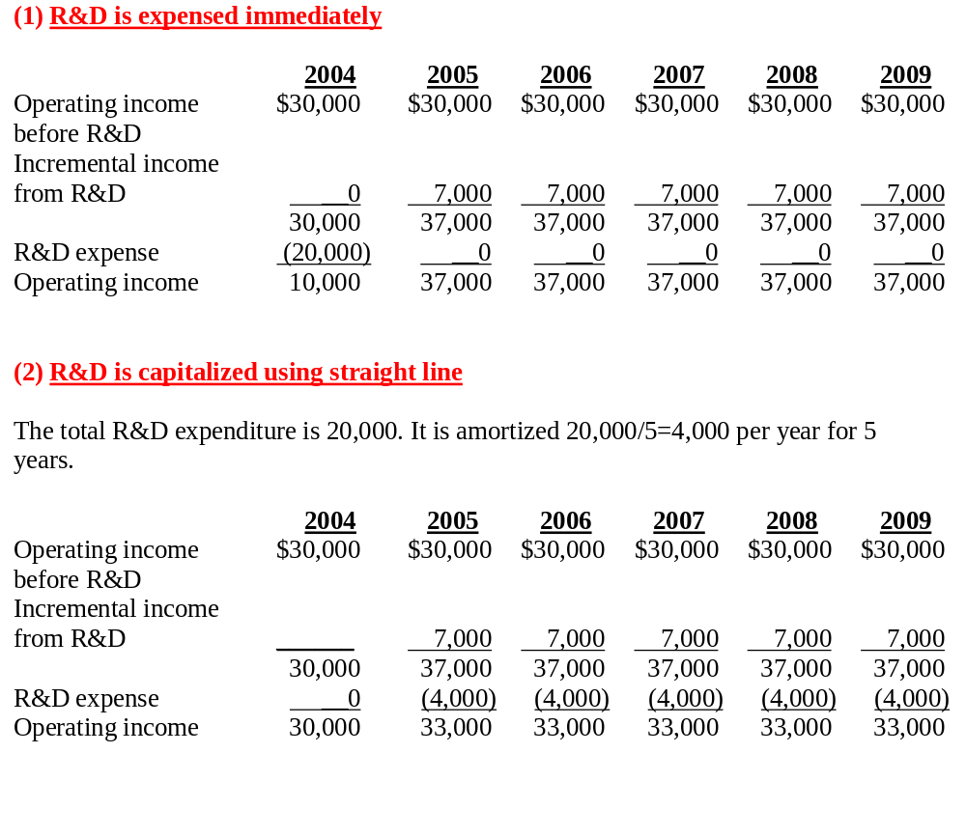
Clinic I-<number>

Slide 41
Fully expensing R&D in the year in which it was incurred results in poor matching in operating income.
Clinic I-<number>

Slide 42
How Financial Reporting Issues Arise
Efficiencies of Generally Accepted Accounting Principles (GAAP)
Examples:
  Assets omitted from the balance sheet: R&D and brand assets
  Off-balance-sheet obligations not recognized (FIN 46 helps to rectify)
  Losses on conversions into common stock and options settled with common stock are not recognized (SFAS 150 attempts to rectify)
Poor Application of Accounting Principles
Examples:
  Excessive restructuring charges (SFAS 146 helps here)
  Biased estimates of bad debts, sales returns, warranties
  Aggressive revenue recognition
  Conservative revenue recognition: Creation of a “cookie jar” with unearned revenue
  “Creative accounting” that yields form over substance: using “bright lines” in GAAP to obscure; structural engineering
Clinic I-<number>

Slide 43
How Should You Deal with the Accounting Issues?
Understand GAAP and its limitations
  Appreciate the relevance-reliability tradeoff
  Recognize unresolved issues in GAAP
  Recognize where choices can be made
Be alert to poor application of GAAP
  How sensitive are earnings to estimates?
  How would you characterize the revenue recognition – aggressive or conservative?
  Does the application of GAAP “faithfully represent” the business?
These issues will come to the fore as we proceed through the book
Clinic I-<number>

Slide 44
Who Sets the Rules (in the U.S.)?
U.S. Congress
Securities and Exchange Commission (SEC)
www.sec.gov
Financial Accounting Standards Board (FASB)
www.fasb.org
From the past:
Accounting Principles Board (APB)
“General Acceptance”
In the future:
How will the International Accounting Standards Board (IASB) influence accounting principles? The SEC Roadmap (Box 2.5)
Clinic I-<number>

